Slide 1


Analyzis of EGNOS Ionospheric model

Slide 2
Introduction

Slide 3
Integrity – the aim of the EGNOS analyzis
Introduction to Integrity
„Integrity is the measure of the trust that can be placed in the correctness of the information supplied by a navigation system. Integrity includes the ability of the system to provide timely warnings to users when the system should not be used for navigation” - This definition was adapted from the 2008 US Federal Navigation Plan - Navipedia
3
CC/ENG2-Bp | 2019-04-11
© Robert Bosch GmbH 2019. All rights reserved, also regarding any disposal, exploitation, reproduction, editing, distribution, as well as in the event of applications for industrial property rights.

Slide 4
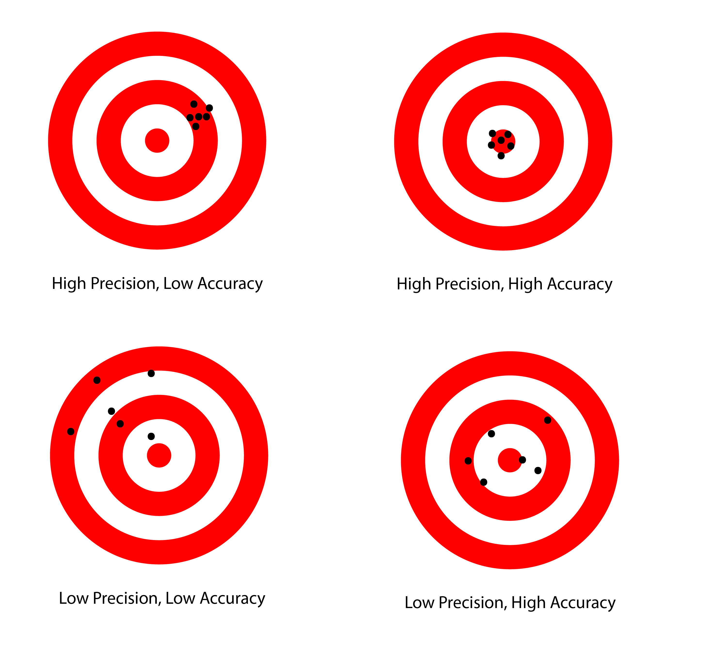
Definition of performace key parameter
Introduction
Accuracy: Measure of navigation output deviating from truth.
Integrity: Ability of a system to provide timely warnings when the system should not be used for navigation. Integrity risk is the probability of an undetected, threatening navigation system problem.
Availability: Fraction of time navigation system is usable as determined by compliance with accuracy, integrity and continuity requirements.
Continuity: Likelihood that the navigation supports accuracy and integrity requirements for the duration of intended operation. Continuity risk is the probability of a detected but unscheduled navigation interruption after initiation of an operation.
Precision
Accuracy
4
CC/ENG2-Bp | 2019-04-11
© Robert Bosch GmbH 2019. All rights reserved, also regarding any disposal, exploitation, reproduction, editing, distribution, as well as in the event of applications for industrial property rights.
Notes:
Let’s recap some main definition in regard of integrity
Pic: https://geocue.com/wp-content/uploads/2015/01/precision-accuracy.png

Slide 5
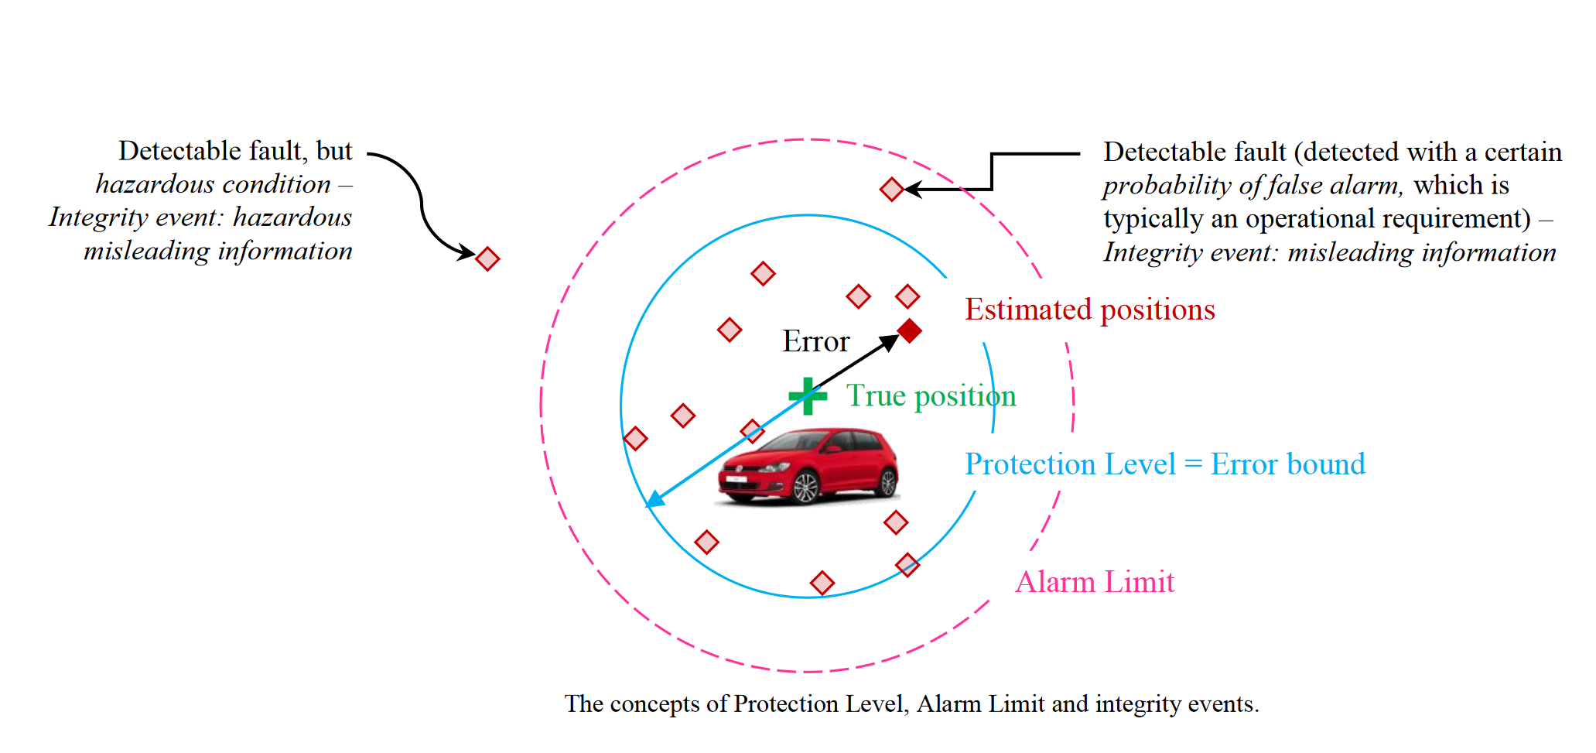
System performance
Introduction
System performance:
Accuracy, Integrity, Availability, Continuity
High accuracy, poor integrity
Integrity monitoring/mechanisms
Poor accuracy, high integrity
5
CC/ENG2-Bp | 2019-04-11
© Robert Bosch GmbH 2019. All rights reserved, also regarding any disposal, exploitation, reproduction, editing, distribution, as well as in the event of applications for industrial property rights.
Notes:
Protection Level def 1: The PL is a statistical error bound computed so as to guarantee that the probability of the absolute position error exceeding said number is smaller than the target integrity risk.
Protection level def 2:the PL defines the smallest position error that mustbe detected with the required probabilities of false alert and missed detection.
misleading information, hazardous misleading information
An error exceeding the PL is a misleading information ( see Fig. ); in case the application also defines an Alarm Limit (AL), the misleading information becomes hazardous as long as the error exceeds also the AL
Ref to car pic:
The need for GNSS position integrity and authentication in ITS: Conceptual and practical limitations in urban contexts
Davide Margaria, Emanuela Falletti, Tankut Acarman
Published in IEEE Intelligent Vehicles Symposium Proceedings 2014
DOI:10.1109/IVS.2014.6856485

Slide 6
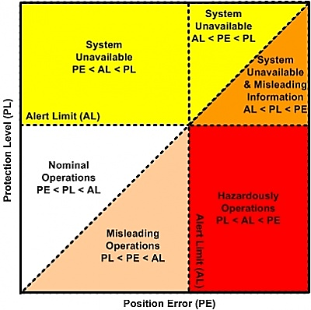
Stanford diagram
Introduction
System performance:
Accuracy, Integrity, Availability, Continuity
High accuracy, poor integrity
Integrity monitoring/mechanisms
AL: Alert Limit
PL: Protection Level
PE: Position Estimation
HMI: Hazardously Misleading Information
Poor accuracy, high integrity
6
CC/ENG2-Bp | 2019-04-11
© Robert Bosch GmbH 2019. All rights reserved, also regarding any disposal, exploitation, reproduction, editing, distribution, as well as in the event of applications for industrial property rights.
Notes:
Standford pic: https://gssc.esa.int/navipedia/index.php/File:Integrity-integrity-failure.jpg
The Stanford diagram (or Stanford plot) introduced in ^{[4]} and improved in ^{[5]} is a quite handy tool to explain an illustrate most of these concepts and their relations (as well as to asses positioning systems’ performance). The layout of a generic Stanford diagram is shown below, in the Stanford diagram figure. For each sample position and protection level, a point is plotted in the Stanford diagram whose abscissa represents the absolute position error and whose ordinate represents its associated protection level. Usually, separate Stanford plots are represented for the horizontal and vertical components of position errors (and corresponding horizontal and vertical protection levels, respectively). The diagonal axis separates those samples in which the position error is covered by the protection level, above the diagonal, from those, below the diagonal, in which the protection level fails to cover the position error. Stanford plots allow an easy and quick check that integrity holds, just by making sure that all sample points lie on the upper side of the diagonal axis. Also, the proximity of the cloud of sample points to the diagonal gives an idea of the achieved level of safety, as any point above the diagonal but very close to it indicates that an integrity event was close to occur.

Slide 7
EGNOS & GINA

Slide 8

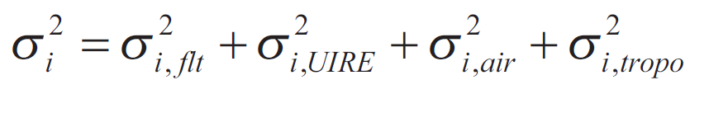
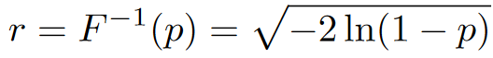

RTCA’s protection level calculation
EGNOS
Horizontal protection level
Variance of the residual after application of ionospehric error
$K_{H}= 6.0 −position probability {10}^{−7}$
Ellipsoid of projection matrix
Inverse cummulative function of 2D Gaussian
Estimation of protection level
8
CC/ENG2-Bp | 2019-04-11
© Robert Bosch GmbH 2019. All rights reserved, also regarding any disposal, exploitation, reproduction, editing, distribution, as well as in the event of applications for industrial property rights.
Notes:
EGOS is an SBAS system and it works under the same standards. So RTCA applies to EGNOS as well.
Integrity in GNSS positioning augmented by SBAS systems is dependent on the geometry of the satellites, the impact of the ionosphere, troposphere, ephemeris errors, delays of GNSS satellites clocks and errors associated with the operation of the receiver itself
KH – a factor bounding user’s horizontal position with a probability of 10-9 (for en-route navigation KH = 6.18 and for precision approach KH = 6.0),
KV – a factor bounding the user’s vertical position with a probability of 0.5x10-7 (= 5.33).
S – projection matrix,
σ i2 – full variance of the pseudorange measurement,
σ i, flt2 – variance of the residual error after application of fast and slow corrections,
σ i,UIRE2 – variance of the residual error after application of ionospheric correction,
σ i,air 2 – variance of the contribution of the receiver to the residual error,
σ i,tropo2 – variance of the residual error after application of tropospheric correction
Radio Technical Committee for Aeronautics (RTCA) “Minimum Operational
Performance Standards for Airborne Equipment Using Global
Positioning System/Wide Area Augmentation System.” Doc. DO-229D.
2006, with Change 1, 2013, Washington, DC. http://www.rtca.org

Slide 9
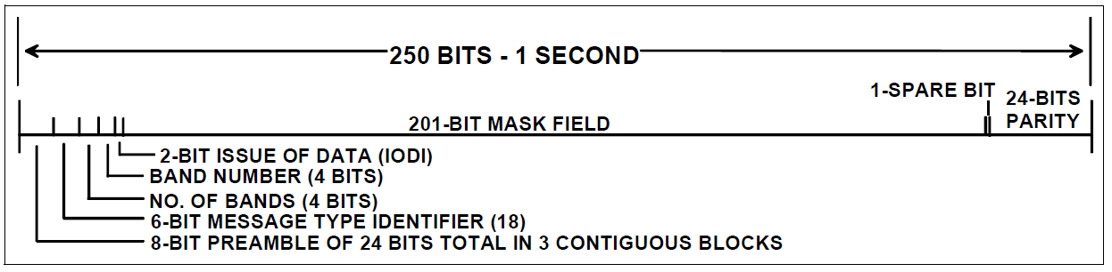
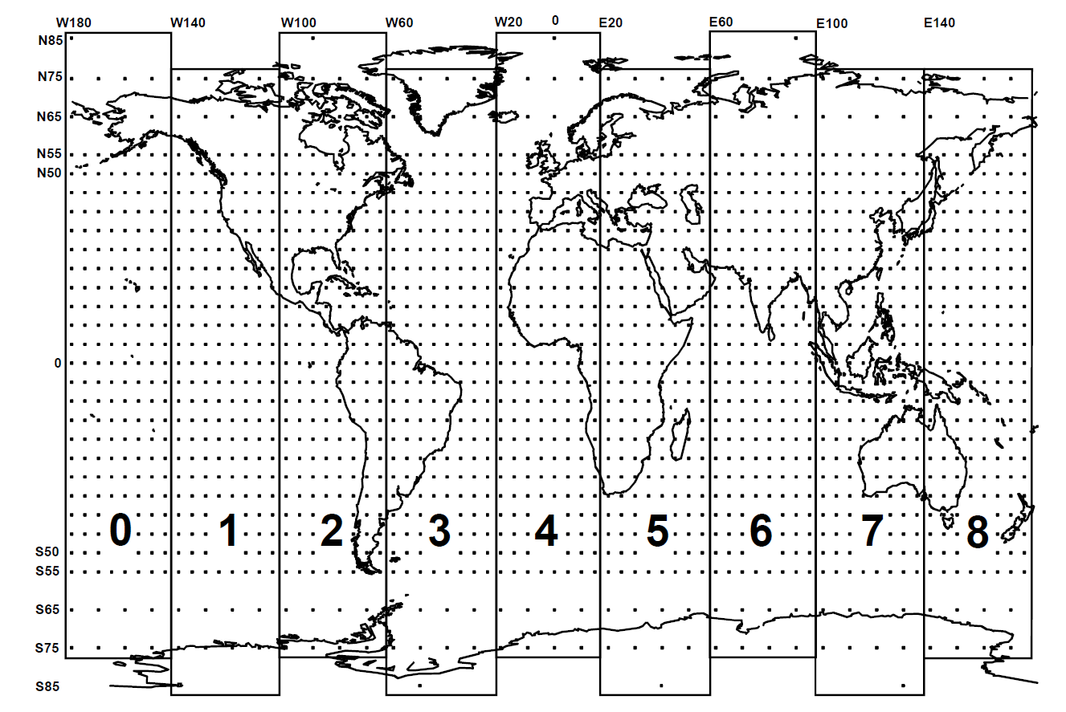
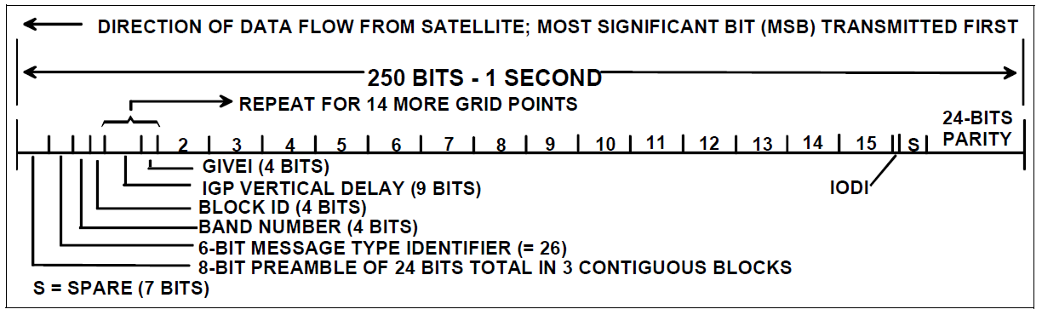
Ionsopheric Grid Point and Message Formats
EGNOS
IGP Mask Message Format
Ionospheric Delay Corrections Message Format
9
CC/ENG2-Bp | 2019-04-11
© Robert Bosch GmbH 2019. All rights reserved, also regarding any disposal, exploitation, reproduction, editing, distribution, as well as in the event of applications for industrial property rights.
Notes:
Type 18 and Type 26 Message

Slide 10
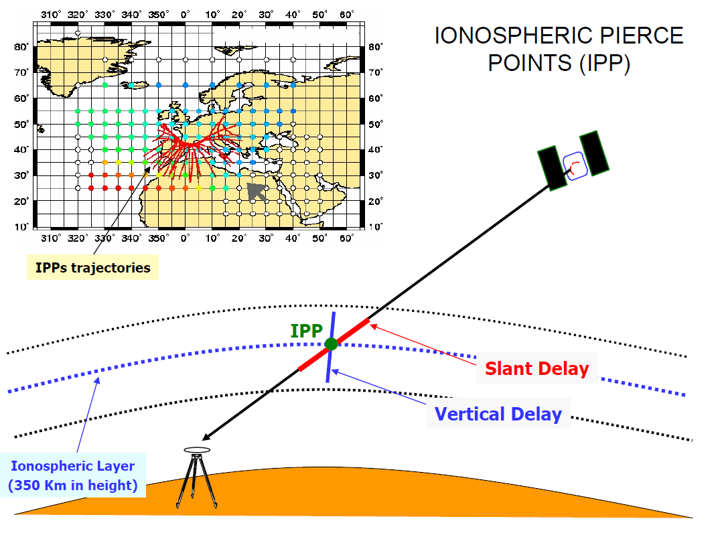
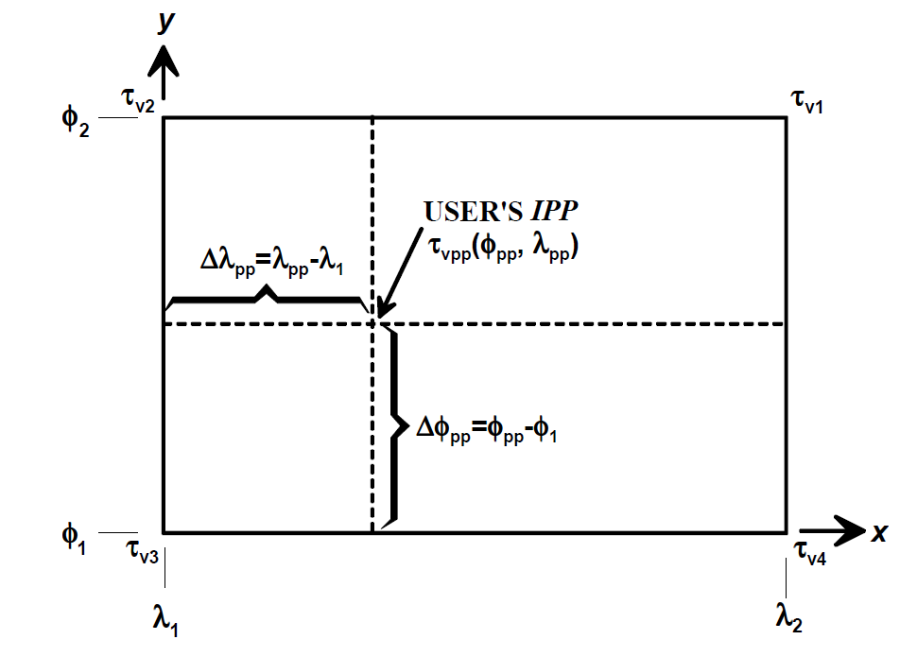
Ionospheric Variance
EGNOS
4 point interpolation algorithm definition
10
CC/ENG2-Bp | 2019-04-11
© Robert Bosch GmbH 2019. All rights reserved, also regarding any disposal, exploitation, reproduction, editing, distribution, as well as in the event of applications for industrial property rights.
Notes:
FPP – obliquity factor that transforms vertical delay to slant,
Wn – weighting function,
σ n,ionogrid2 – grid ionospheric vertical error bound with degradation over time,
xPP, yPP – coordinates of interpolation grid points,
σ GIVE2 – grid ionospheric vertical error bound,
σ iono2 – degradation of ionospheric correction information
If the degradation model (using Message Types 7 and 10) is used, σ2 ionogrid is calculated as described in section A.4.5.2. If the degradation model is not used, but WAAS provided ionospheric model is used, σ2ionogrid equals σ2GIVE
Pics:
EGNOS TUTORIAL (ppt)
Research group of Astronomy and GEomatics(gAGE/UPC)
UniversitatPolitècnicade Catalunya e-mail: jaume@mat.upc.es http://gage1.upc.es
Manuel Hernández-Pajares, J. Miguel Juan, Jaume Sanz, Xavier Prats, February 2002.

Slide 11
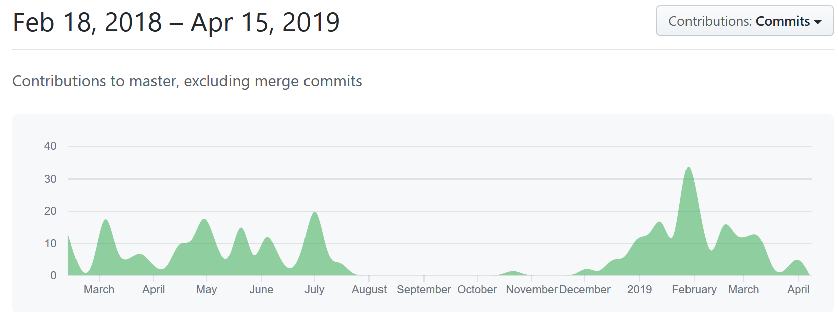

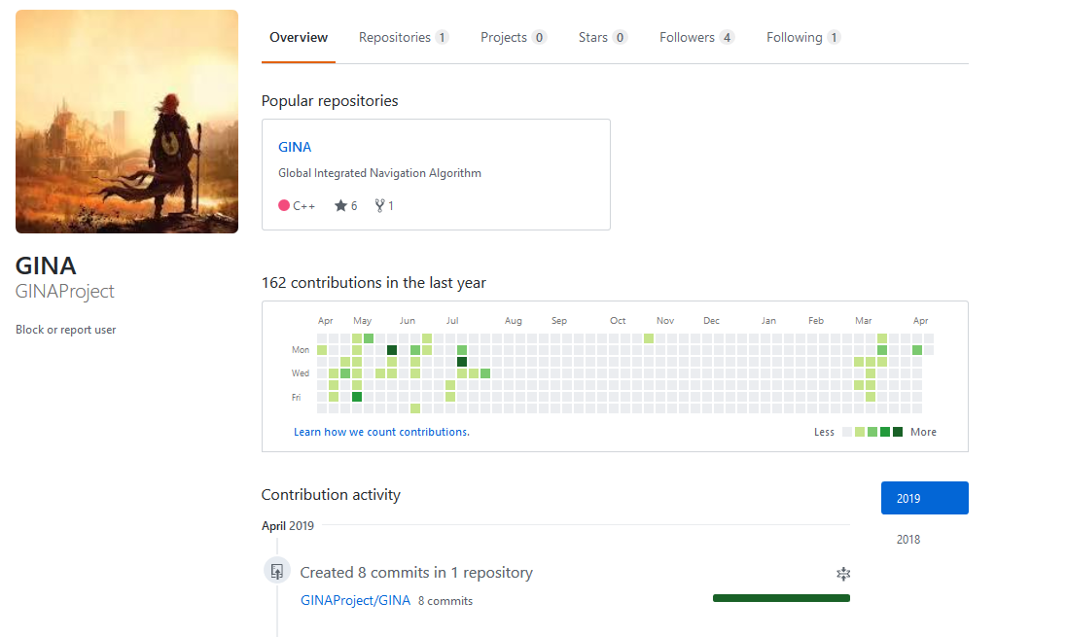


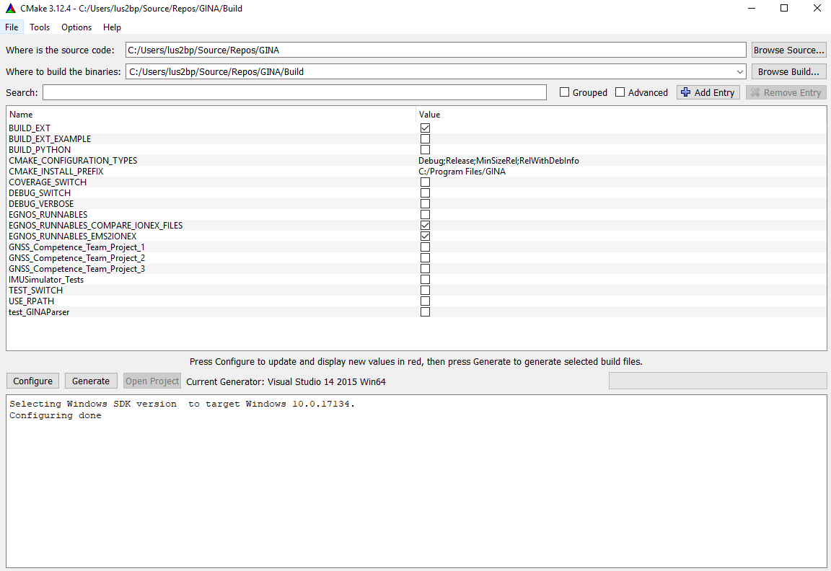



EGNOS
GINA – Global Integrated Navigation Algorithm
Cmake based C++ project
Github Repo
Evaulation with Octova/Matlab
EGNOS is the latest module in GINA
It contains ~5000 Line of Code
11
CC/ENG2-Bp | 2019-04-11
© Robert Bosch GmbH 2019. All rights reserved, also regarding any disposal, exploitation, reproduction, editing, distribution, as well as in the event of applications for industrial property rights.

Slide 12
EGNOS Features – EMS Processing
EGNOS - GINA
Create IONEX file from EMS
Difference of IONEX files
12
CC/ENG2-Bp | 2019-04-11
© Robert Bosch GmbH 2019. All rights reserved, also regarding any disposal, exploitation, reproduction, editing, distribution, as well as in the event of applications for industrial property rights.

Slide 13
Raw measurement
EGNOS - GINA
13
CC/ENG2-Bp | 2019-04-11
© Robert Bosch GmbH 2019. All rights reserved, also regarding any disposal, exploitation, reproduction, editing, distribution, as well as in the event of applications for industrial property rights.

Slide 14
Interpolated IGPs
EGNOS - GINA
14
CC/ENG2-Bp | 2019-04-11
© Robert Bosch GmbH 2019. All rights reserved, also regarding any disposal, exploitation, reproduction, editing, distribution, as well as in the event of applications for industrial property rights.

Slide 15
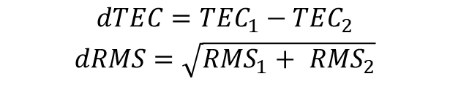
EMS – CODE’s GIM
EGNOS - GINA
$$dTEC={TEC}_{1}−{TEC}_{2}$$
$$dRMS=\sqrt{{RMS}_{1}+ {RMS}_{2}}$$
15
CC/ENG2-Bp | 2019-04-11
© Robert Bosch GmbH 2019. All rights reserved, also regarding any disposal, exploitation, reproduction, editing, distribution, as well as in the event of applications for industrial property rights.

Slide 16
EGNOS Features – Navigation Engine with EGNOS Iono Model
EGNOS - GINA
Calculate position with IONEX correction
16
CC/ENG2-Bp | 2019-04-11
© Robert Bosch GmbH 2019. All rights reserved, also regarding any disposal, exploitation, reproduction, editing, distribution, as well as in the event of applications for industrial property rights.

Slide 17
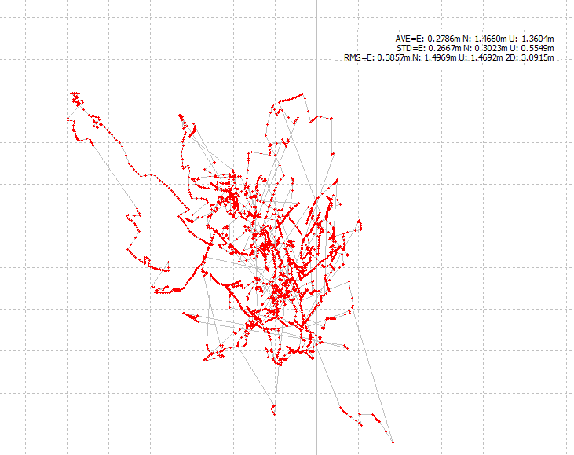
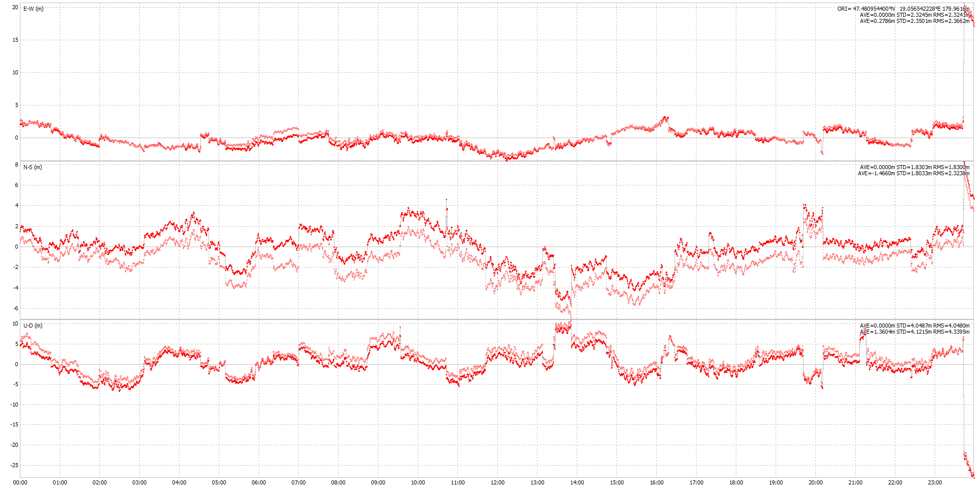
Navigation Engine with EGNOS Iono Model
EGNOS - GINA
Position Difference Ground Track
EMS-CODE
Position with EMS and with CODE
17
CC/ENG2-Bp | 2019-04-11
© Robert Bosch GmbH 2019. All rights reserved, also regarding any disposal, exploitation, reproduction, editing, distribution, as well as in the event of applications for industrial property rights.

Slide 18
Bayesian approach

Slide 19
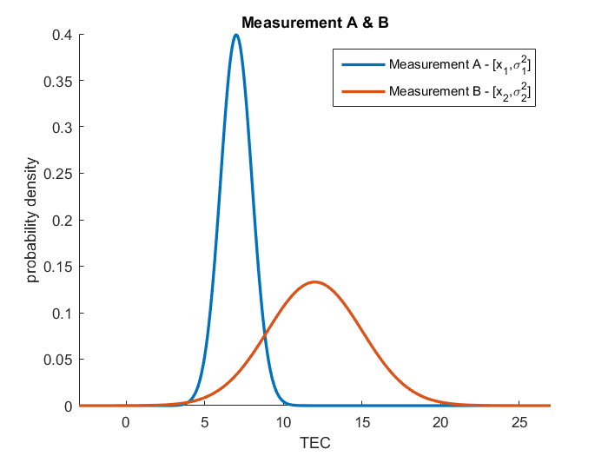
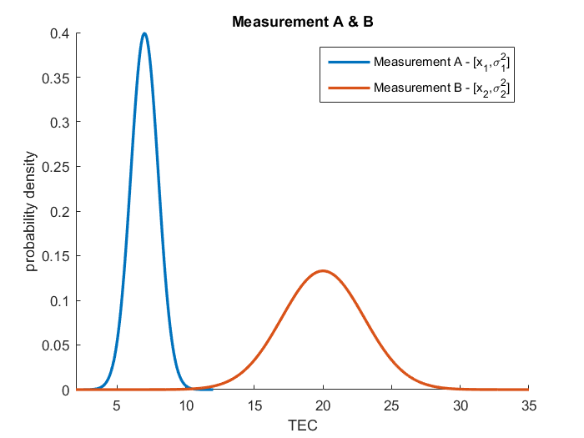
Are the measurements consistent?
Bayesian statistic
19
CC/ENG2-Bp | 2019-04-11
© Robert Bosch GmbH 2019. All rights reserved, also regarding any disposal, exploitation, reproduction, editing, distribution, as well as in the event of applications for industrial property rights.

Slide 20
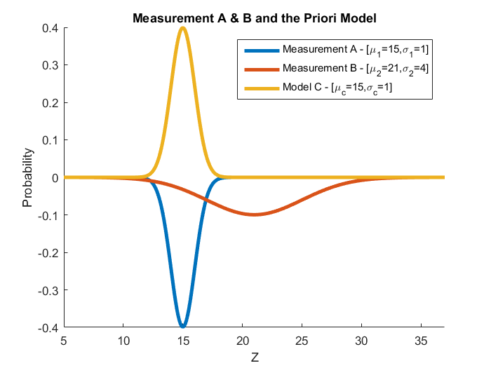

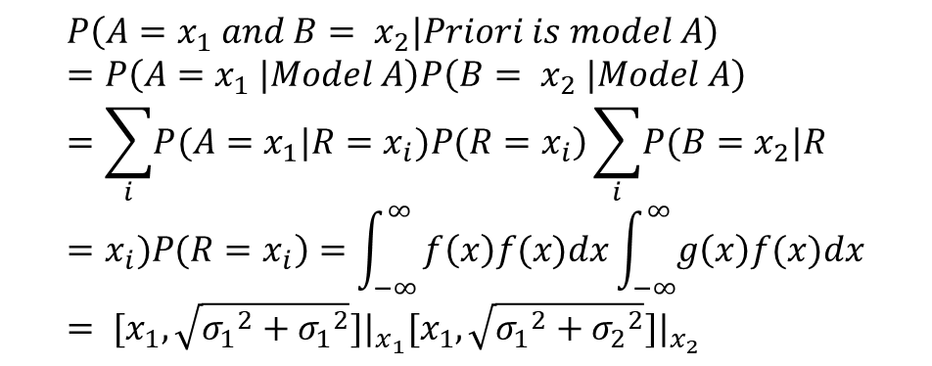
Priori beleif is the Measurement A
Likelihood of the measurements
$$P\left(A=x_{1} and B= x_{2}|Priori is model C\right)=?$$
$$P\left(A=x_{1} and B= x_{2}|Priori is model A\right)=P\left(A=x_{1} |Model A\right)P\left(B= x_{2} |Model A\right)=\sum_{i}{\left.P(A=x_{1}|R=x_{i})P(R=x_{i}\right)}\sum_{i}{\left.P(B=x_{2}|R=x_{i})P(R=x_{i}\right)}=\int_{−∞}^{∞}{f\left(x\right)f(x)dx\int_{−∞}^{∞}{g\left(x\right)f(x)dx}}= [x_{1},\sqrt{{σ_{1}}^{2}+{σ_{1}}^{2}}]|_{x_{1}}[x_{1},\sqrt{{σ_{1}}^{2}+{σ_{2}}^{2}}]|_{x_{2}}$$
Priori
Model
g(x)
f(x)
20
CC/ENG2-Bp | 2019-04-11
© Robert Bosch GmbH 2019. All rights reserved, also regarding any disposal, exploitation, reproduction, editing, distribution, as well as in the event of applications for industrial property rights.

Slide 21
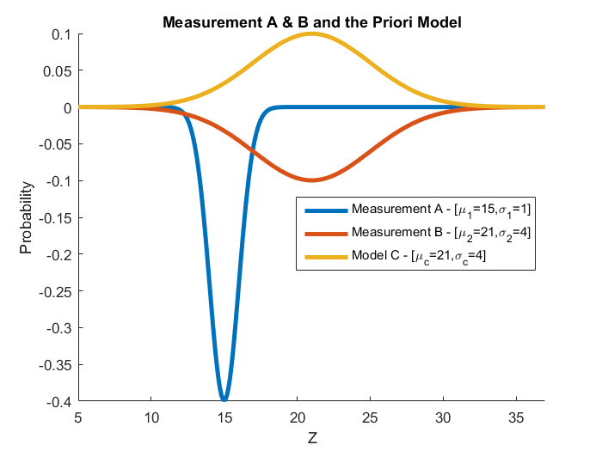
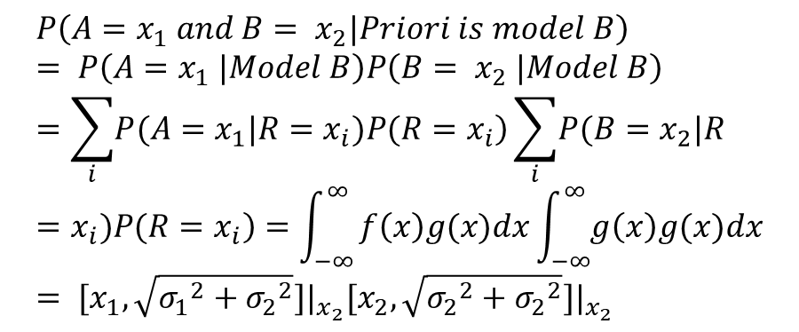
Priori beleif is the Measurement B
Likelihood of the measurements
$$P\left(A=x_{1} and B= x_{2}|Priori is model C\right)=?$$
Priori
Model
$$P\left(A=x_{1} and B= x_{2}|Priori is model B\right)= P\left(A=x_{1} |Model B\right)P\left(B= x_{2} |Model B\right)=\sum_{i}{\left.P(A=x_{1}|R=x_{i})P(R=x_{i}\right)}\sum_{i}{\left.P(B=x_{2}|R=x_{i})P(R=x_{i}\right)}=\int_{−∞}^{∞}{f\left(x\right)g(x)dx\int_{−∞}^{∞}{g\left(x\right)g(x)dx}}= [x_{1},\sqrt{{σ_{1}}^{2}+{σ_{2}}^{2}}]|_{x_{2}}[x_{2},\sqrt{{σ_{2}}^{2}+{σ_{2}}^{2}}]|_{x_{2}}$$
g(x)
f(x)
21
CC/ENG2-Bp | 2019-04-11
© Robert Bosch GmbH 2019. All rights reserved, also regarding any disposal, exploitation, reproduction, editing, distribution, as well as in the event of applications for industrial property rights.

Slide 22
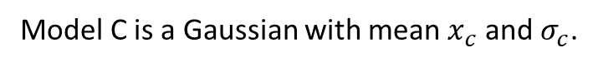

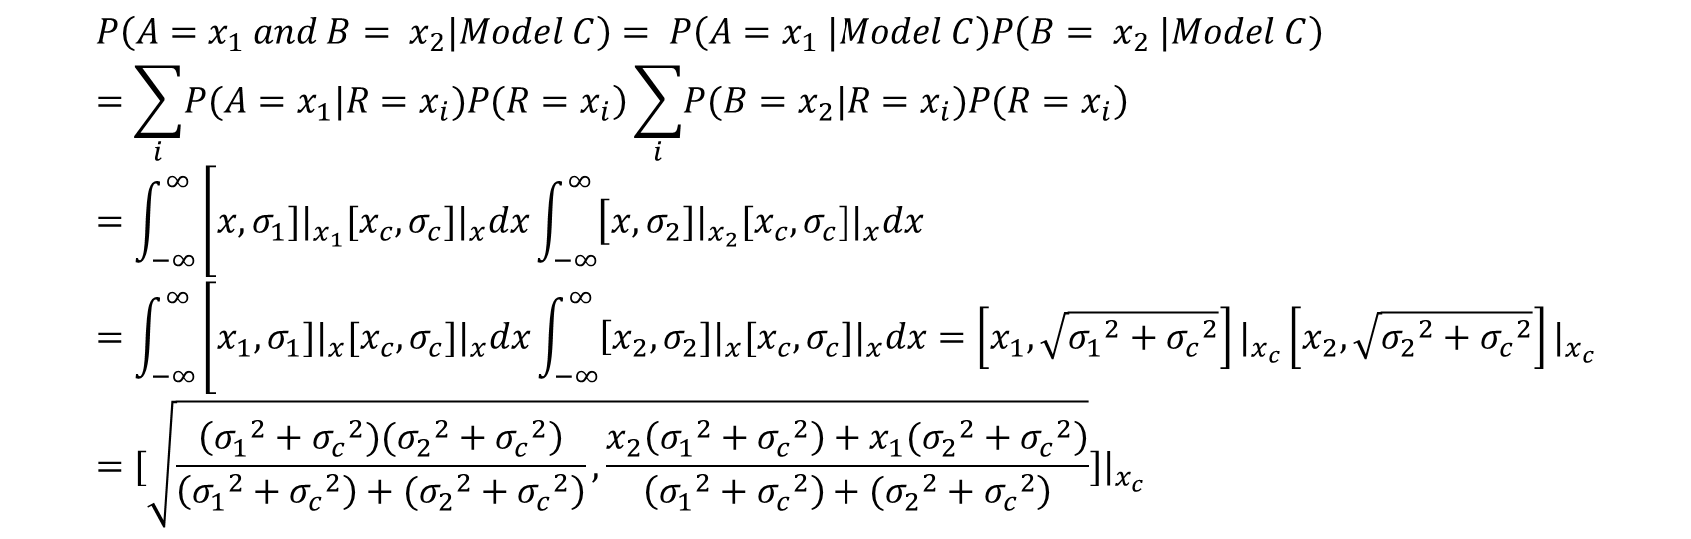
Which Priori Model would give the maximum likelihood?
Likelihood of the measurements
$$P\left(A=x_{1} and B= x_{2}|Priori is model C\right)$$
Model C is a Gaussian with mean $x_{c}$ and $σ_{c}$.
$$P\left(A=x_{1} and B= x_{2}|Model C\right)= P\left(A=x_{1} |Model C\right)P\left(B= x_{2} |Model C\right)=\sum_{i}{\left.P(A=x_{1}|R=x_{i})P(R=x_{i}\right)}\sum_{i}{\left.P(B=x_{2}|R=x_{i})P(R=x_{i}\right)}=\int_{−∞}^{∞}{\left[x,σ_{1}]|_{x_{1}}[x_{c},σ_{c}]|_{x}dx\int_{−∞}^{∞}{\left[x,σ_{2}]|_{x_{2}}[x_{c},σ_{c}]|_{x}dx\right.}\right.}=\int_{−∞}^{∞}{\left[x_{1},σ_{1}]|_{x}[x_{c},σ_{c}]|_{x}dx\int_{−∞}^{∞}{\left[x_{2},σ_{2}]|_{x}[x_{c},σ_{c}]|_{x}dx\right.}\right.}=\left[x_{1},\sqrt{{σ_{1}}^{2}+{σ_{c}}^{2}}\right]|_{x_{c}}\left[x_{2},\sqrt{{σ_{2}}^{2}+{σ_{c}}^{2}}\right]|_{x_{c}}=[\sqrt{\frac{\left({σ_{1}}^{2}+{σ_{c}}^{2})({σ_{2}}^{2}+{σ_{c}}^{2}\right)}{\left.\left({σ_{1}}^{2}+{σ_{c}}^{2}\right)+({σ_{2}}^{2}+{σ_{c}}^{2}\right)},\frac{\left.x_{2}\left({σ_{1}}^{2}+{σ_{c}}^{2}\right)+x_{1}({σ_{2}}^{2}+{σ_{c}}^{2}\right)}{\left.\left({σ_{1}}^{2}+{σ_{c}}^{2}\right)+({σ_{2}}^{2}+{σ_{c}}^{2}\right)}}]|_{x_{c}}$$
22
CC/ENG2-Bp | 2019-04-11
© Robert Bosch GmbH 2019. All rights reserved, also regarding any disposal, exploitation, reproduction, editing, distribution, as well as in the event of applications for industrial property rights.

Slide 23
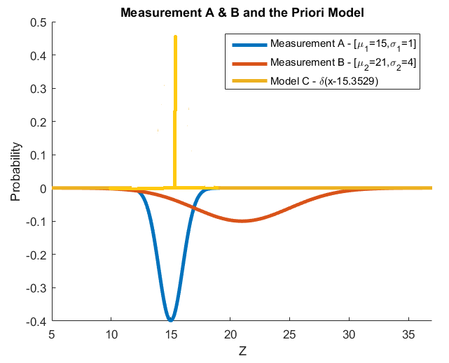

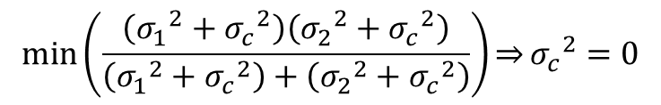
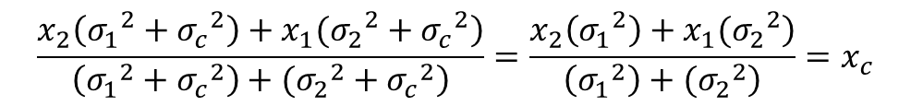
Which Priori Model would give the maximum likelihood?
Likelihood of the measurements
$$\min\left(\frac{\left({σ_{1}}^{2}+{σ_{c}}^{2}\right)\left({σ_{2}}^{2}+{σ_{c}}^{2}\right)}{\left({σ_{1}}^{2}+{σ_{c}}^{2}\right)+\left({σ_{2}}^{2}+{σ_{c}}^{2}\right)}\right)\underset{⇒}{}{σ_{c}}^{2}=0$$
$$\frac{\left.x_{2}\left({σ_{1}}^{2}+{σ_{c}}^{2}\right)+x_{1}({σ_{2}}^{2}+{σ_{c}}^{2}\right)}{\left.\left({σ_{1}}^{2}+{σ_{c}}^{2}\right)+({σ_{2}}^{2}+{σ_{c}}^{2}\right)}=\frac{\left.x_{2}\left({σ_{1}}^{2}\right)+x_{1}({σ_{2}}^{2}\right)}{\left.\left({σ_{1}}^{2}\right)+({σ_{2}}^{2}\right)}=x_{c}$$
$$\left.\lim_{σ→0}{\frac{1}{\sqrt{2π}σ}e^{−\frac{1}{2}\frac{{\left(x−μ\right)}^{2}}{σ^{2}}}}=δ(x−μ)\right)$$
23
CC/ENG2-Bp | 2019-04-11
© Robert Bosch GmbH 2019. All rights reserved, also regarding any disposal, exploitation, reproduction, editing, distribution, as well as in the event of applications for industrial property rights.

Slide 24
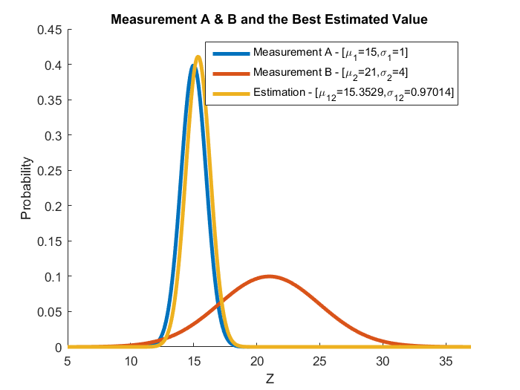
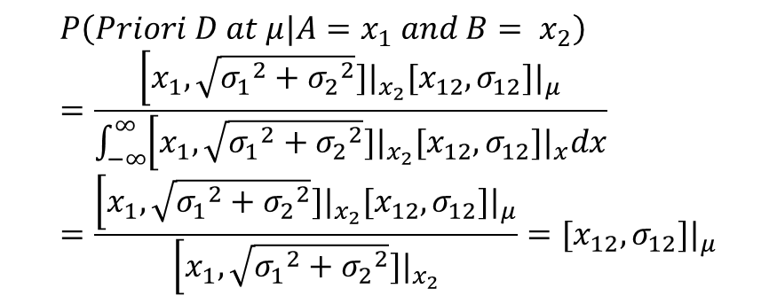
But wouldn’t we get the same result with a Kalman filter or LSQ?
Maximum likelihood
$$P\left(Priori D at μ|A=x_{1} and B= x_{2}\right)=\frac{\left[x_{1},\sqrt{{σ_{1}}^{2}+{σ_{2}}^{2}}]|_{x_{2}}[x_{12},σ_{12}]|_{μ}\right.}{\int_{−∞}^{∞}{\left[x_{1},\sqrt{{σ_{1}}^{2}+{σ_{2}}^{2}}]|_{x_{2}}[x_{12},σ_{12}]|_{x}dx\right.}}=\frac{\left[x_{1},\sqrt{{σ_{1}}^{2}+{σ_{2}}^{2}}]|_{x_{2}}[x_{12},σ_{12}]|_{μ}\right.}{\left[x_{1},\sqrt{{σ_{1}}^{2}+{σ_{2}}^{2}}]|_{x_{2}}\right.}=[x_{12},σ_{12}]|_{μ}$$
24
CC/ENG2-Bp | 2019-04-11
© Robert Bosch GmbH 2019. All rights reserved, also regarding any disposal, exploitation, reproduction, editing, distribution, as well as in the event of applications for industrial property rights.

Slide 25

Think Tank
Next Steps
25
CC/ENG2-Bp | 2019-04-11
© Robert Bosch GmbH 2019. All rights reserved, also regarding any disposal, exploitation, reproduction, editing, distribution, as well as in the event of applications for industrial property rights.

Slide 26

Thank you

